Slide 1
SCSJ3553
Artificial intelligence
Chapter 4
Strategies for State Space Search (Heuristic Search)

Slide 2
Heuristics Search
(rules of thumb): Weak search method because it is based on experience or intuition.
Have long been a core concern in AI research
Used to prune spaces of possible solution
When to employ Heuristic?
1. A problem may not have an exact solution.
- e.g. medical diagnosis: doctors use heuristic
2. A problem may have an exact solution, but the computational cost of finding it may be prohibitive.
- e.g in chess (exhaustive or brute-force search)

Slide 3
Heuristics Search
In computer science, a brute-force search consists of systematically enumerating every possible solution of a problem until a solution is found, or all possible solutions have been exhausted.
For example, an anagram problem can be solved by enumerating all possible combinations of words with the same number of letters as the desired phrase, and checking one by one whether the words make a valid anagram.

Slide 4
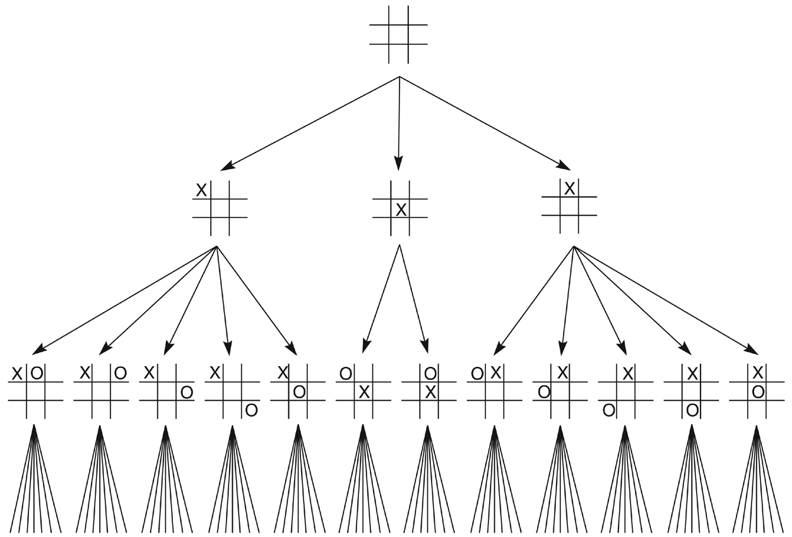
Eg. To Reduce search=> First three levels of the tic-tac-toe state space reduced by symmetry (simple heuristic-most winning opportunities)

Slide 5
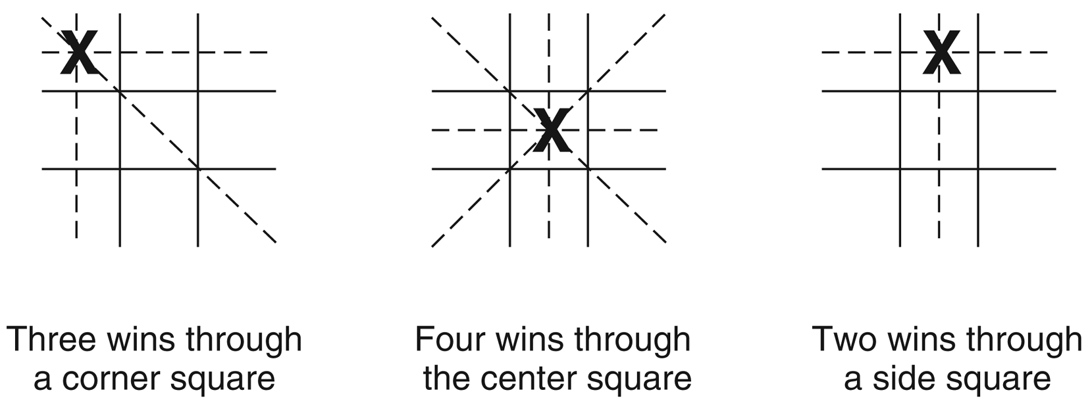
The “most wins” heuristic applied to the first children in tic-tac-toe.

Slide 6
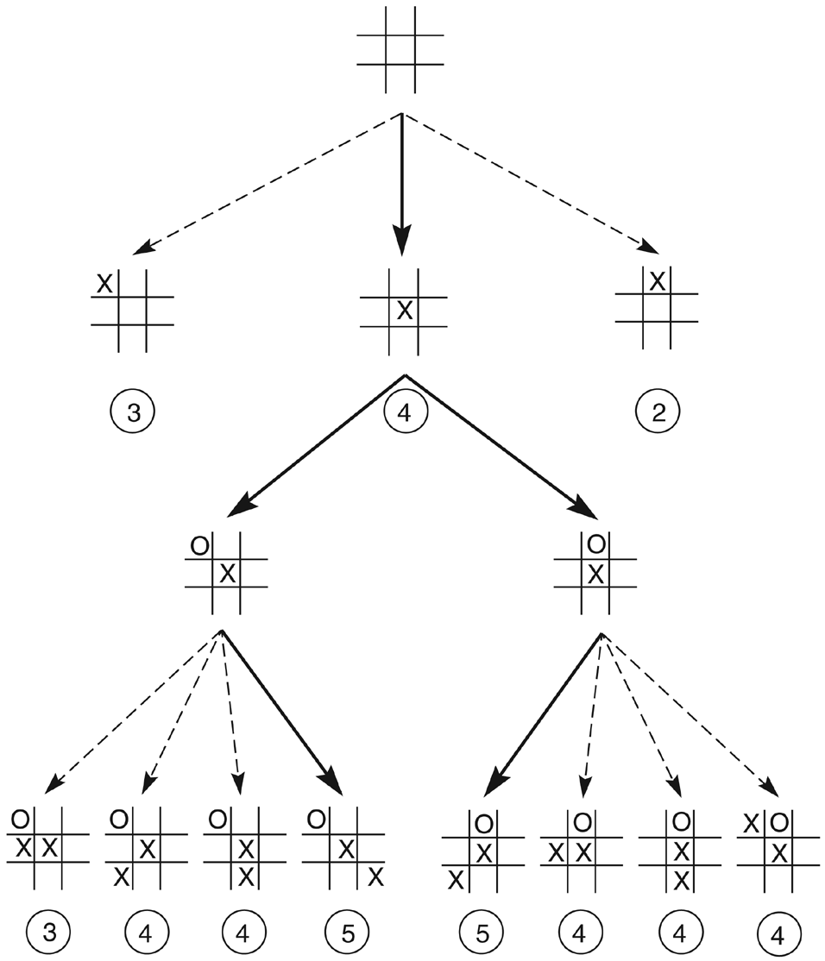
Heuristically reduced state space for tic-tac-toe.

Slide 7
HEURISTIC SEARCH (rules of thumb)
Can be viewed as two parts:
-the heuristic measure
- an algorithm that uses it
An Algorithm for heuristic search: HILL CLIMBING

Slide 8
simplest, the best child is selected for further expansion
limited memory, no backtracking and recovery
Problem with hill climbing:
  An erroneous heuristic can lead along an infinite paths that fail.
  Can stuck at local maxima – reach a state that is better evaluation than its children, the algorithm halts.
  There is no guarantee optimal performance
Advantage:-
  Can be used effectively if the heuristic is sufficient

Slide 9
It is a general algorithm for heuristically searching any state space graph
Supports a variety of heuristic evaluation functions

Slide 10
Better and flexible Algorithm for heuristic search
BEST-FIRST SEARCH:
  Avoid local maxima, dead ends; has open and close lists
  selects the most promising state
  apply heuristic and sort the ‘best’ next state in front of the list (priority queue) – can jump to any level of the state space
  If lead to incorrect path, it may retrieve the next best state

Slide 11
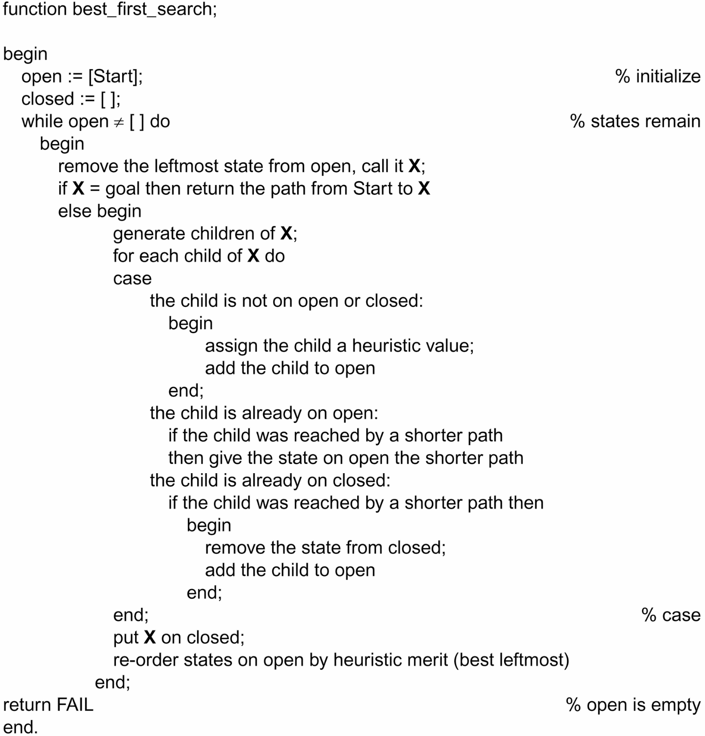
function best_first_search algorithm

Slide 12
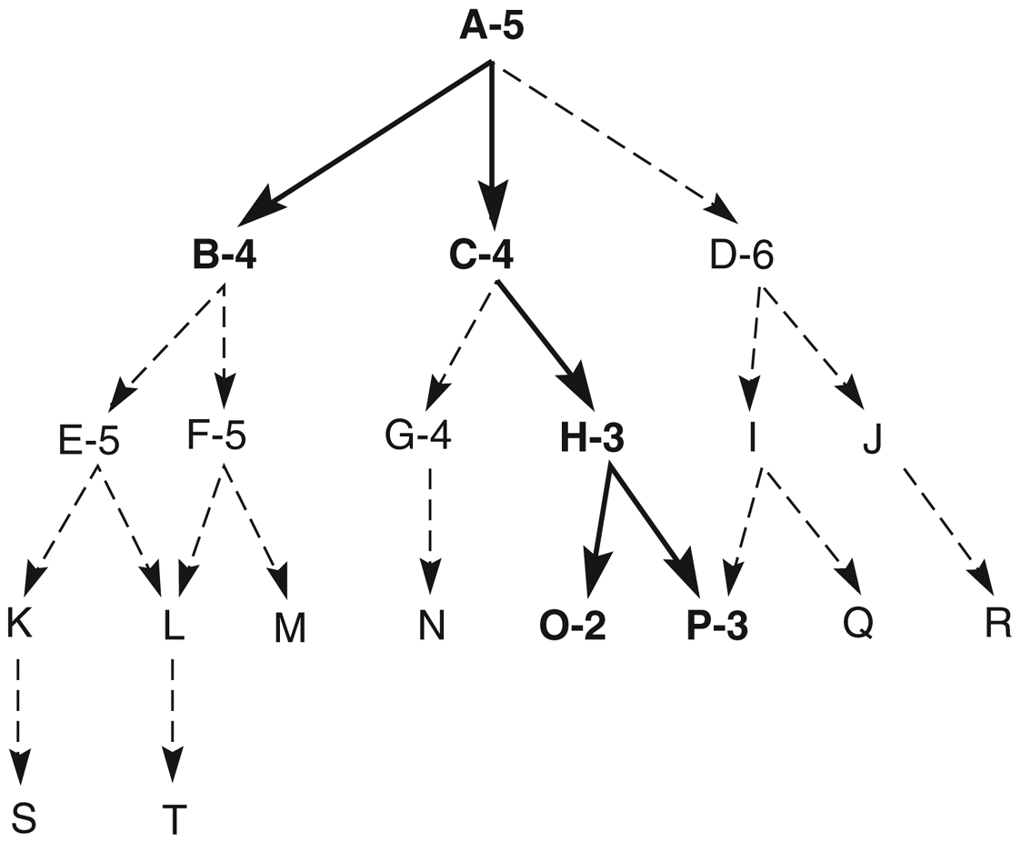
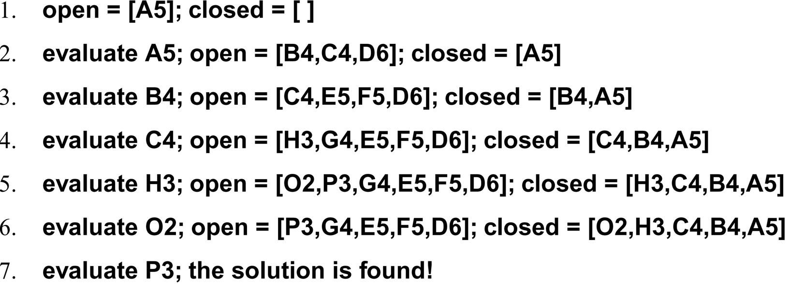
Heuristic search of a hypothetical state space.

Slide 13
A trace of the execution of best_first_search for Figure 4.4
Q1: open nodes to visit are sorted in what order?
Q2: closed nodes?

Slide 14
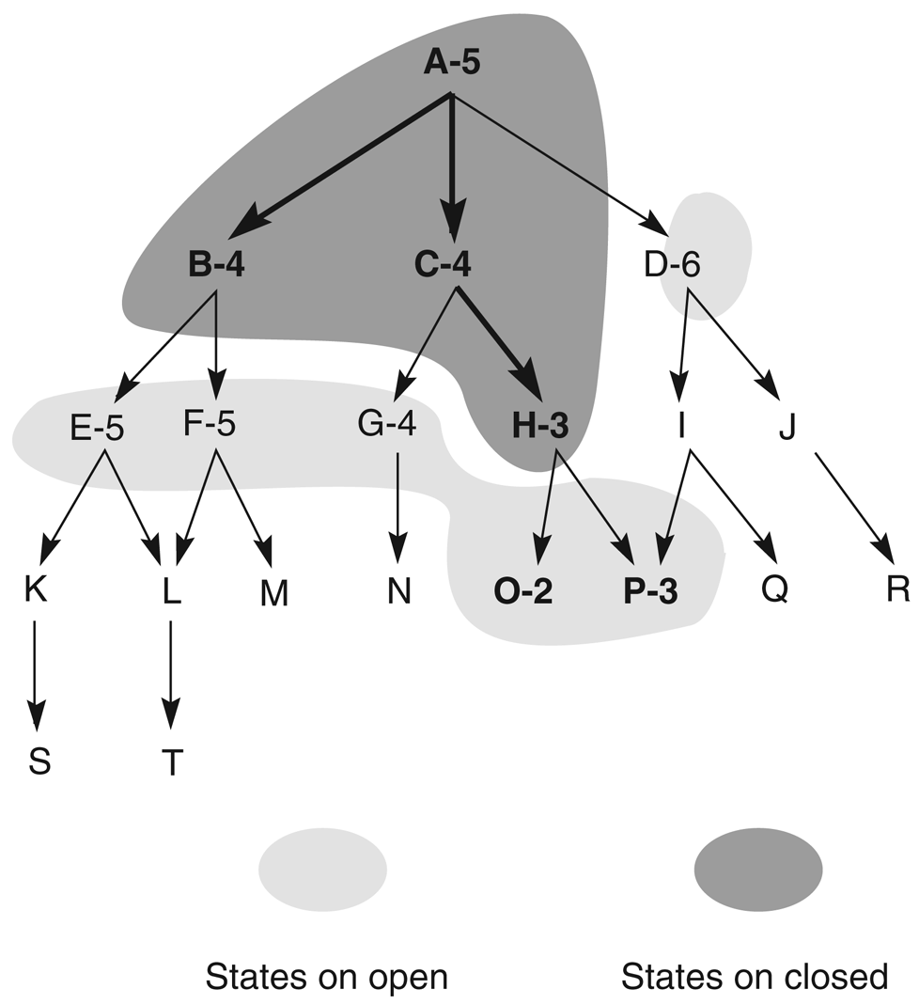
Figure 4.5: Heuristic search of a hypothetical state space with open and closed states highlighted.

Slide 15
HEURISTIC EVALUATION FUNCTION f(n)
To evaluate performances of heuristics for solving a problem.
Devise good heuristic using limited information to make intelligent choices.
To better heuristic, f(n)=g(n)+h(n), where h(n) distance from start to n, g(n) is distance from n to goal
Eg. 8-puzzle, heuristics h(n) could be:
  No. of tiles in wrong position
  No. of tiles in correct position
  Number of direct reversal (2X)
  Sum of distances out of place
And g(n) is the depth measure

Slide 16
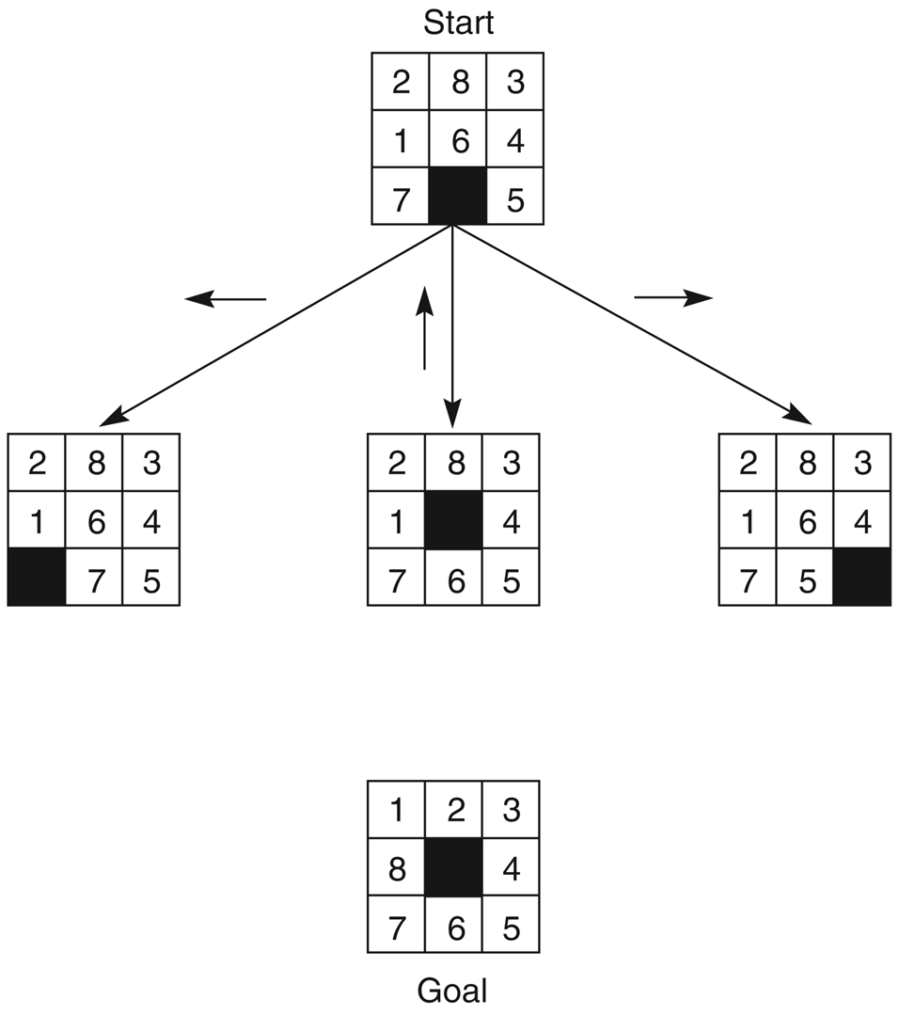
The start state, first set of moves, and goal state for an 8-puzzle instance.
f(n)=g(n)+h(n)
g(n)=actual dist. From n to start
h(n)=no. of tiles in wrong position
g(n)=0
g(n)=1
h(n) =?? h(n) =?? h(n) =??
f(n)=?? f(n)= ?? f(n)=??

Slide 17
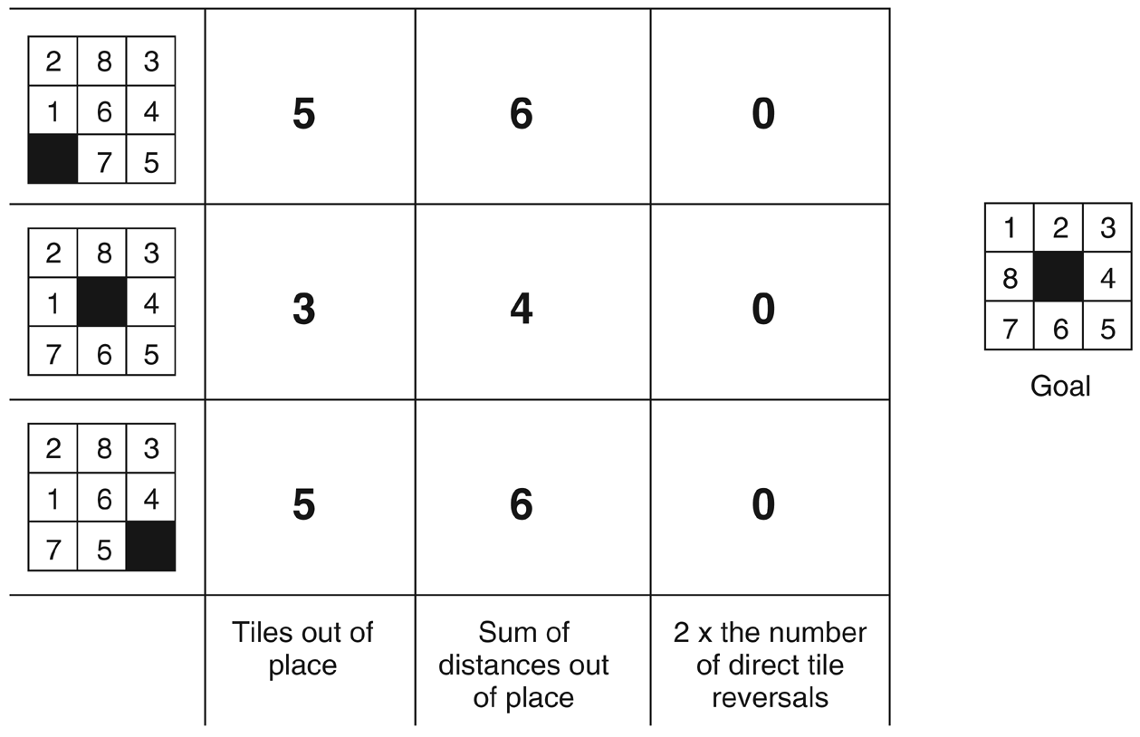
Three heuristics applied to states in the 8-puzzle.
-Devising good heuristics is sometimes difficult; OUR GOAL is to use the limited information available to make INTELLIGENT CHOICE

Slide 18
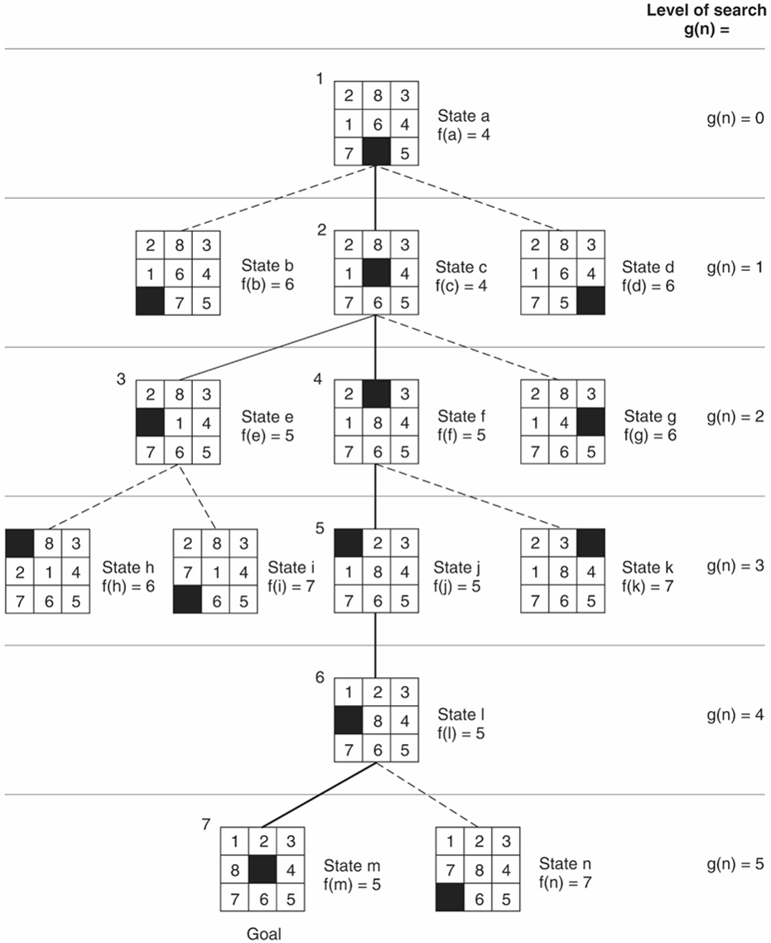
f(n)=g(n)+h(n)
g(n)=actual dist. From n to start
h(n)=no. of tiles in wrong position
State space generated in heuristic search of the 8-puzzle graph.
Full best-first-search of 8 puzzle

Slide 19
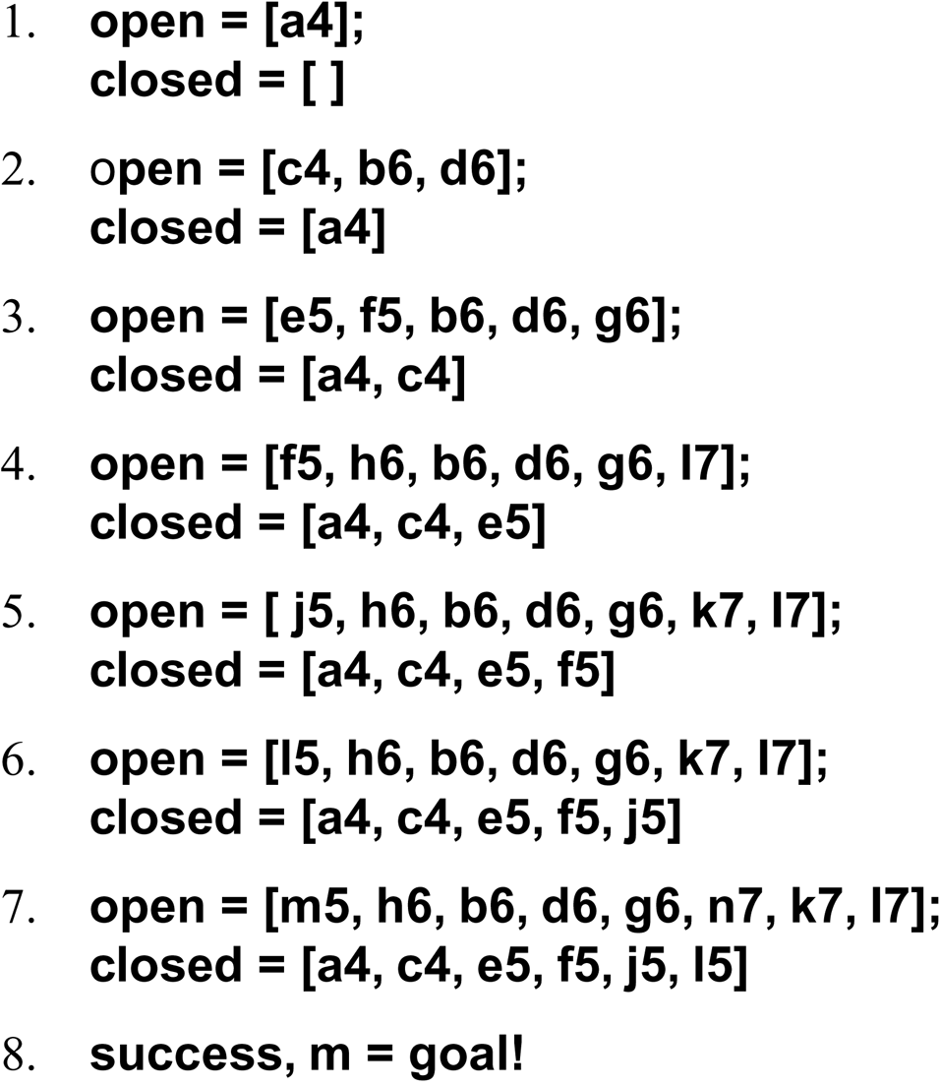
The successive stages of open and closed that generate previous graph are:

Slide 20
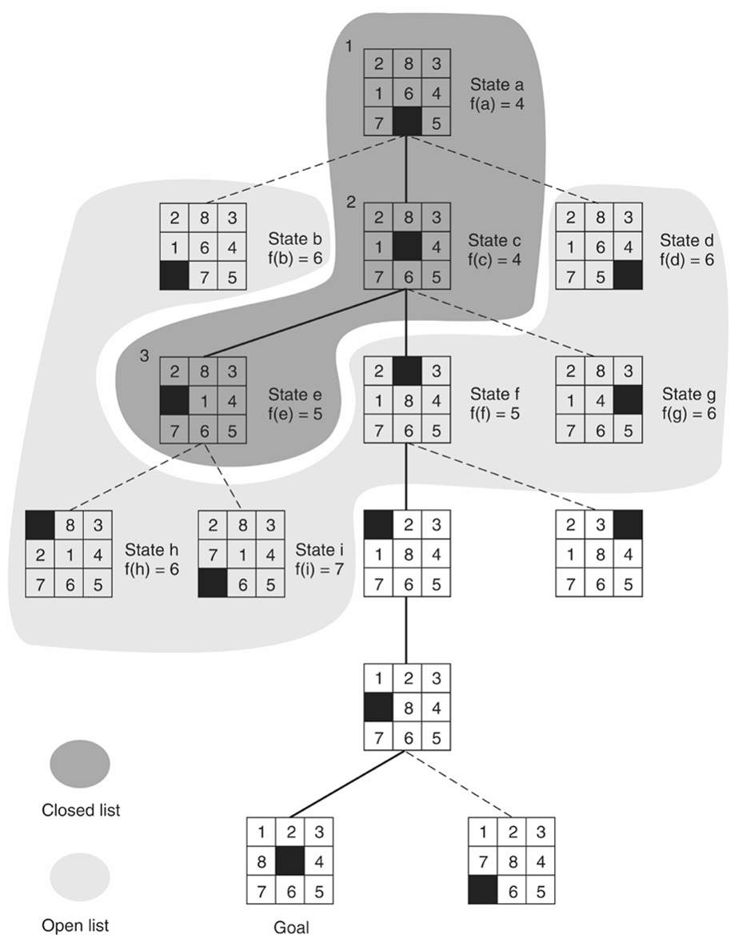
open and closed as they appear after the third iteration of heuristic search.

